Slide 1
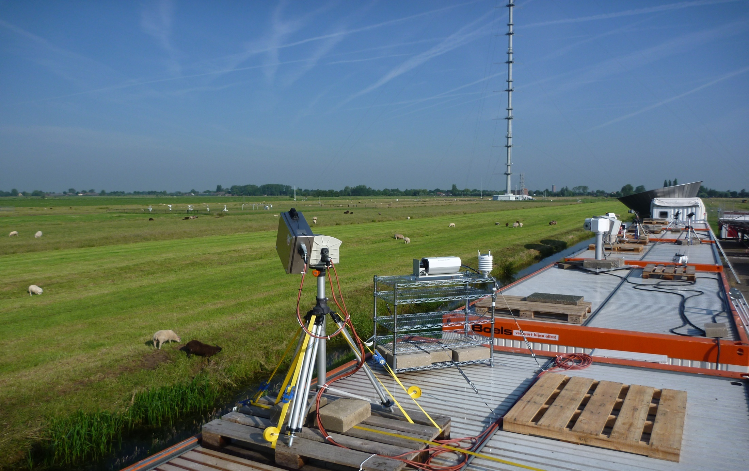
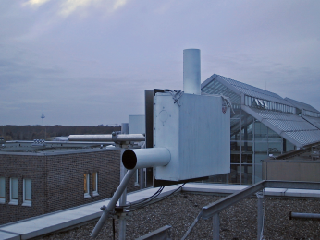
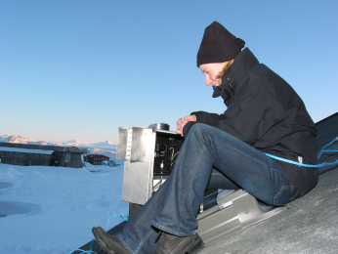
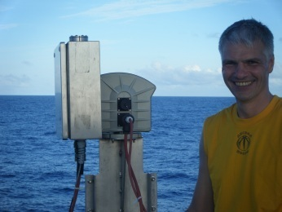
BREDOM network– Overview and Plans
Folkard Wittrock, iup Bremen

Slide 2
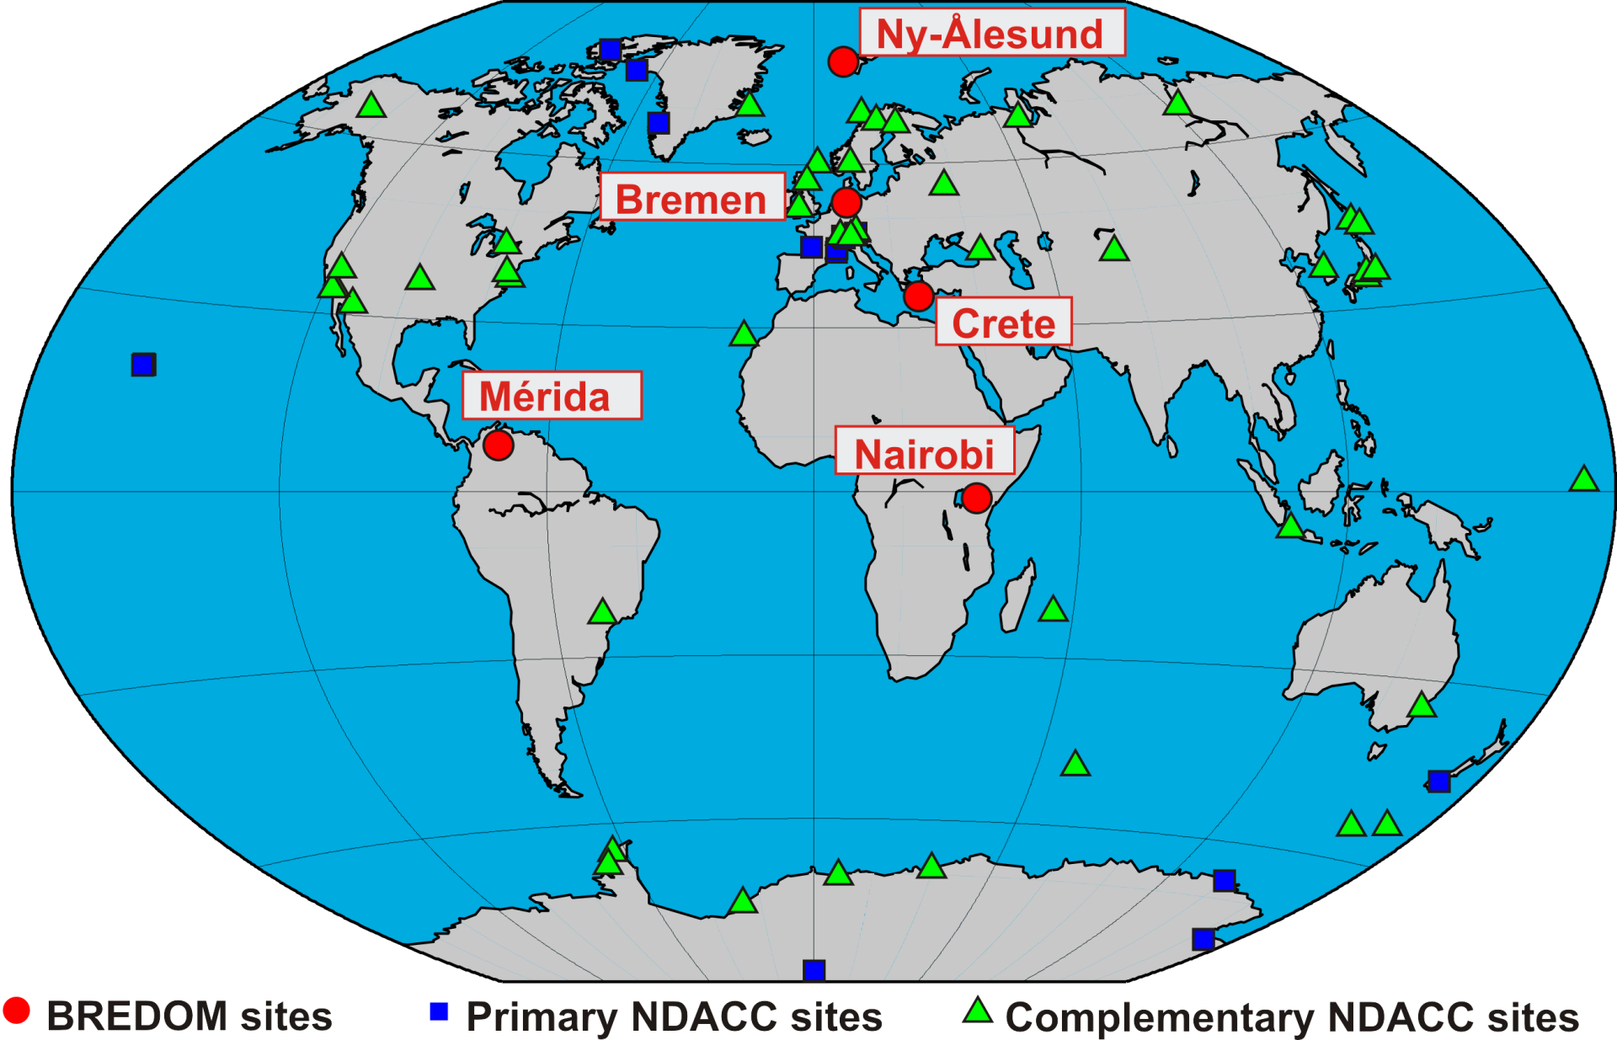
Bremian DOAS network for atmospheric measurements (BREDOM)

Slide 3
BREDOM
Long-term stations:
Ny-Ålesund (79°N) : since 1995 (2002)
FINO 1 (54°N) : Januar 2013 to
Bremen (53°N) : since 1993 (2004)
Athens (38° N) : September 2012 to Heraklion (35°N) : August 2007 to January 2010
Mérida (8°N) : March 2004 to Mai 2009
Nairobi (1°S) : since July 2002
NDACC qualified instruments
all stations equipped with MAX-DOAS

Slide 4
BREDOM
Campaigns and temporary stations:
OHP (France) : 06. – 07. 1996 (NDACC intercomparison)
Kaashidhoo (Maledive) : 02. – 03.1998 (INDOEX)
Po valley (Italy) : 07. – 08.2002 and 08. – 09.2003 (FORMAT)
Andoya (Norway) : 02. – 03.2003 (NDACC intercomparison)
Zugspitze (Germany) : 02.2003 – 07.2003
Summit (Greenland) : 08.2003 – 03.2005
Sylt (Germany) : 03. – 09.2004
Cabauw (Netherlands) : 06. – 07.2005 , 09.2006 (DANDELIONS)
and 06. – 07.2009 (CINDI, NDACC intercomparison)
RV Polarstern: 08.-10.2006 (ANTXXIII-7) and 04.-05.2008 (ANTXXIV-4)
RV Sonne : 10.2009 (TRANSBROM) and 11.2011 (SHIVA)
Finokalia (Crete) : 06.2007 – 08.2007
Semporna (Malaysia, Borneo): 11.2011
North Sea (German Bight): 11.2012 and 08.2013

Slide 5
Upgrades
Ny-Ålesund:
new UV-CCD in 2012
pan-tilt head since 2010
Bremen:
new pan-tilt-head for azimuthal scans
new spectrometers both for UV and Visible
In 2012:
Development of a new, more robust MAX-DOAS system for Deutsche Bucht (new project in cooperation with the BSH)

Slide 6
MeSmarT – Measurement of ship emissions in the marine troposphere

Slide 7
MeSmarT
MAX-DOAS and in situ measurements (NO₂ and SO₂)
FINO 1 45 km North of Borkum (Borkum Riff, N 54° 0,86‘ E 6° 35,26‘)
In addition ship cruises in the German bight (all seasons)

Slide 9
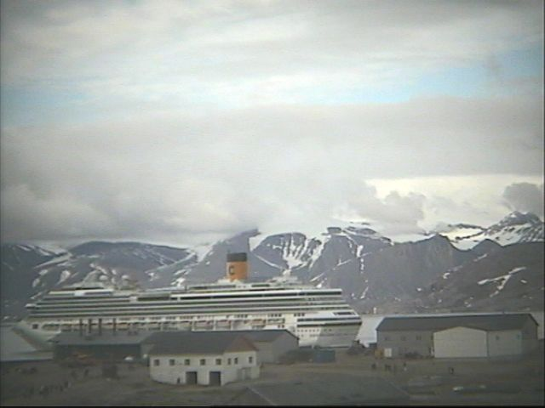

Slide 11
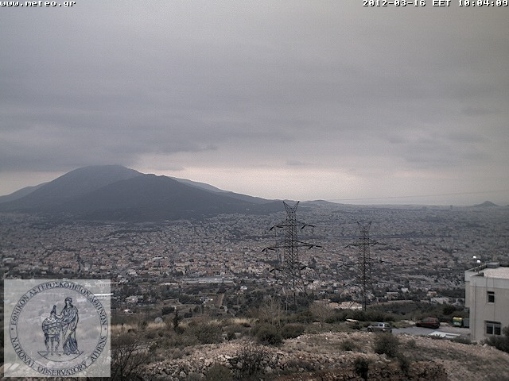
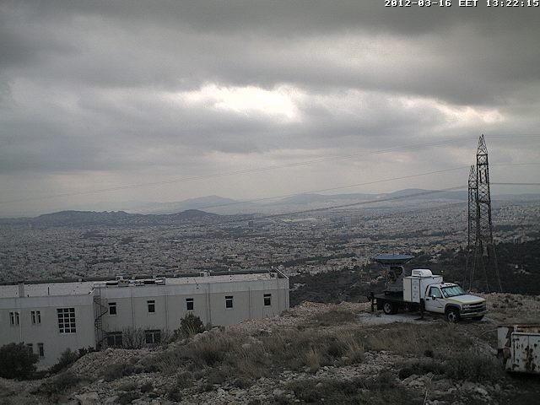
Athens
MAX-DOAS, in situ and aerosol observations
Will be installed at the Pentelli hill with free view to almost the whole Athens area

Slide 12
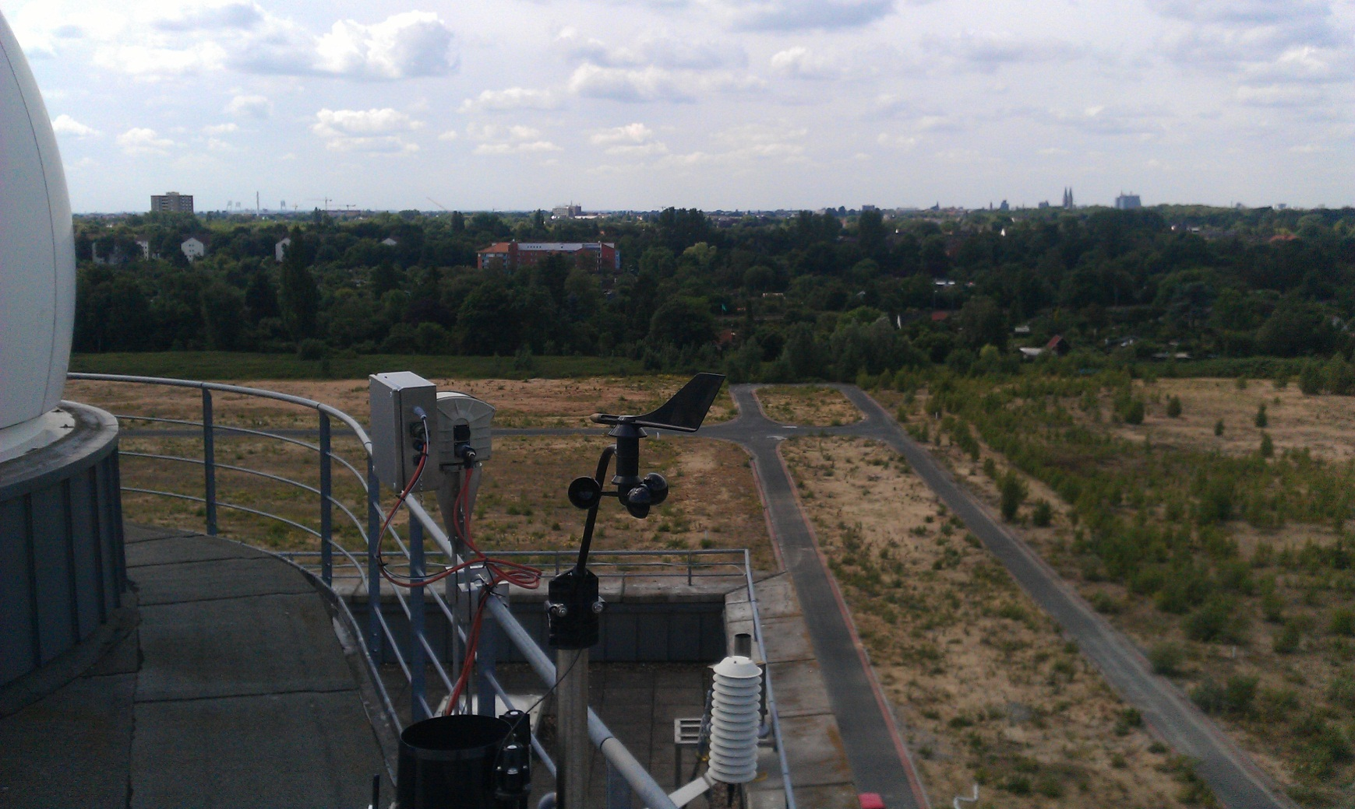
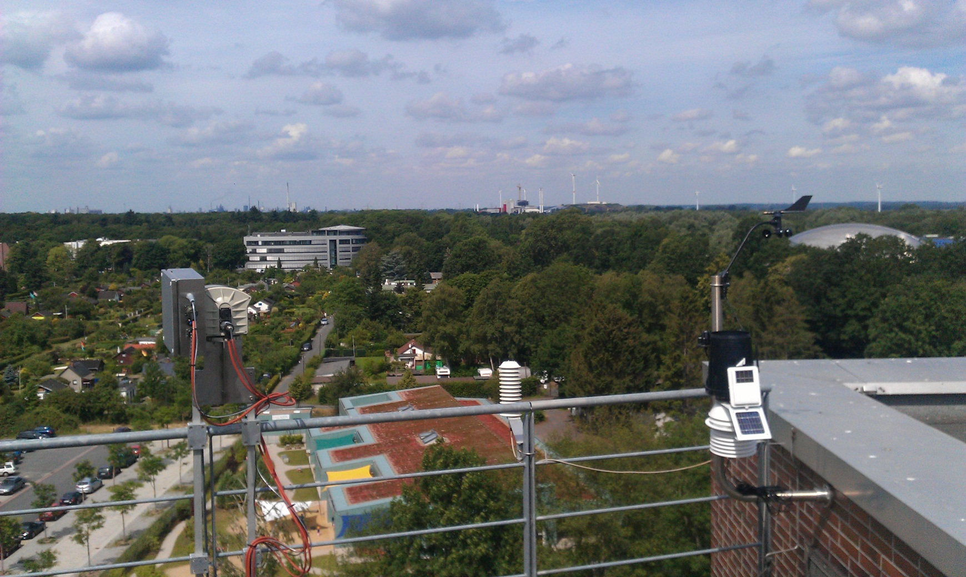
BREDOM – Bremen

Slide 13
BREDOM
In situ vs. MAX-DOAS 2010
Correlation 0.68
Slope 1.2
In situ affected by interference?

Slide 14
BREDOM
Data delivery
Last upload of Bremen,Nairobi, Ny-Ålesund data in September 2011
Near real time analysis succesfully tested for Ny-Ålesund
-> daily data upload should be possible for all sites
Financial support for all sites until 2014
Last publication:
E. Peters et al., Formaldehyde and nitrogen dioxide
over the remote western Pacific Ocean:
SCIAMACHY and GOME-2 validation
http://www.atmos-chem-phys-discuss.net/12/15977/2012/

