Slide 1
Gap Analysis for Integrated Atmospheric ECV CLImate Monitoring (GAIA-CLIM )
Horizon 2020 Project Characterising satellite measurements
using in-situ, ground-based and sub-
orbital capabilities
NERSC (coordinator)
BIRA (WP lead)
CNR (WP lead)
MO (WP lead)
BKS (WP lead)
EUMETSAT (WP lead)
ECMWF
KNMI
FMI
MPG
Bremen University
Tallinn University of Technology
NPL
Helsinki University
Bergamo University
Lille University
KIT
Plus NOAA, NASA (no cost)

Slide 2
Aim of this project:
to lead to significant advances in consistency and validation of long-term space-based measurements with high-quality ground-based data streams
to provide a better overview of the uncertainty in available measurements to generate reference quality climate data records

Slide 3
A virtual observatory to visualize, interrogate and download co-location data and uncertainties between satellite and high-quality ground-based data sets (WP5)
Fig.: Examples of output tools that may be provided through the virtual observatory facility.

Slide 4
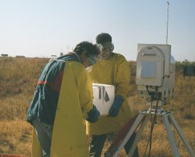
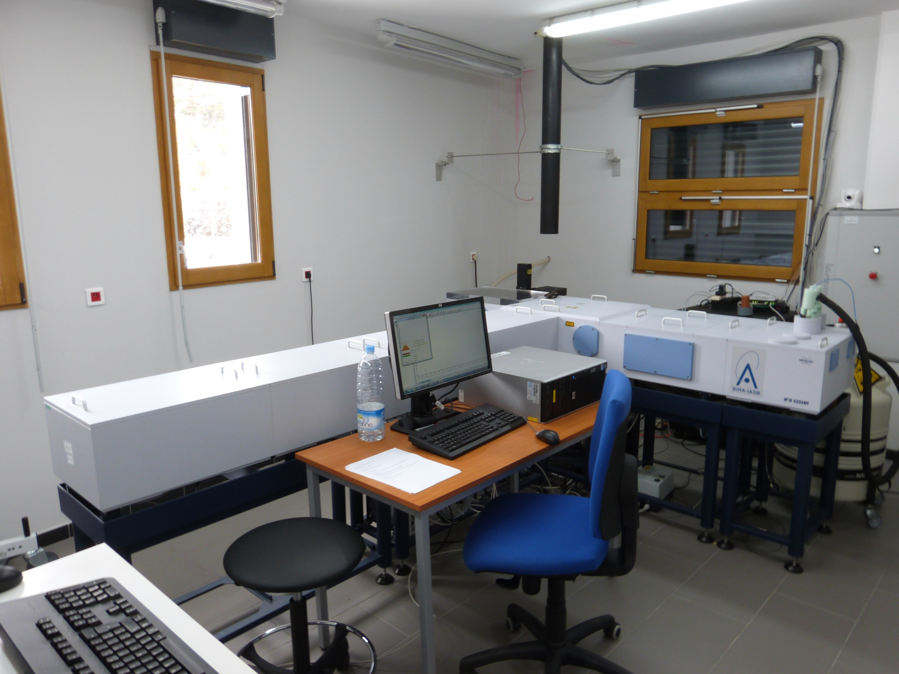
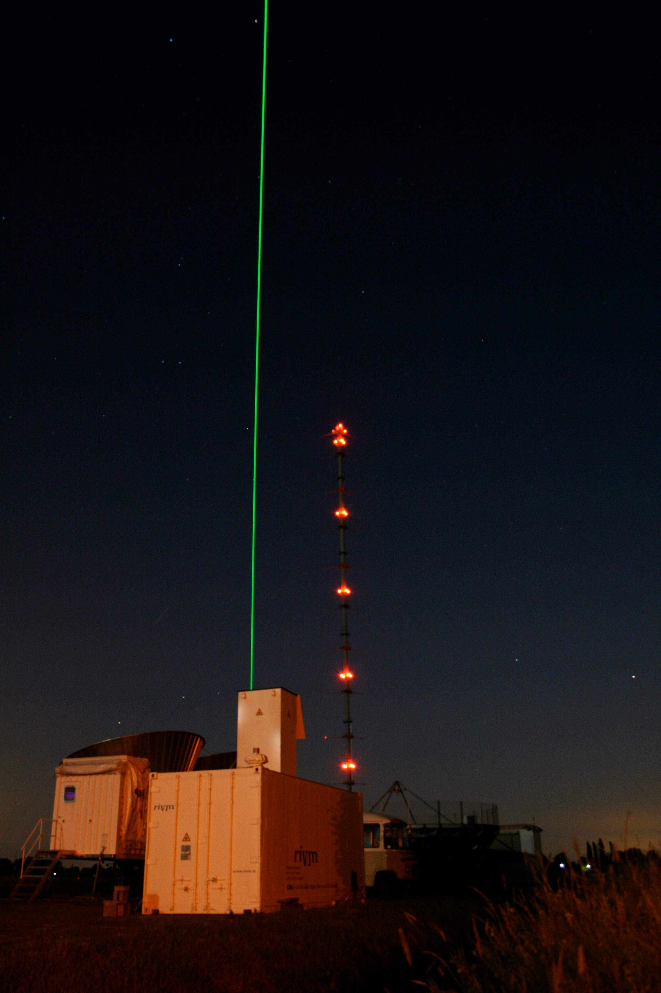
WP2 - Quantifying measurement uncertainties
From the complete list of key ECVs, a subset of ECVs measured with techniques mature enough to be very likely candidates for data streams of reference quality has been selected:
Microwave Radiometers:
T and H₂O profiles
Fourier Transform Spectrometers:
CH₄, CO₂, O₃ and H₂O
columns and profiles
LIDAR:
Aerosol, H₂O, O₃ and T profiles

Slide 5
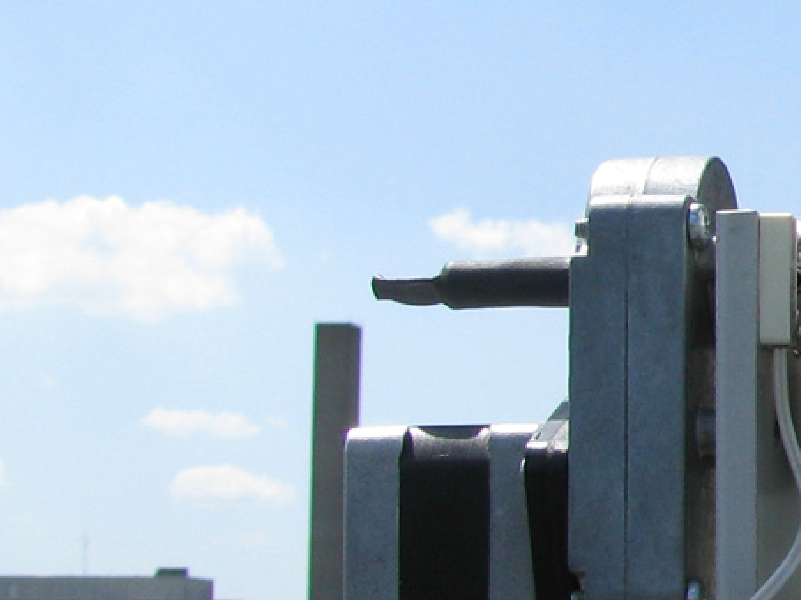
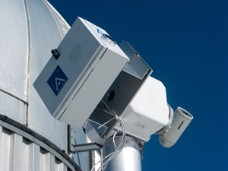
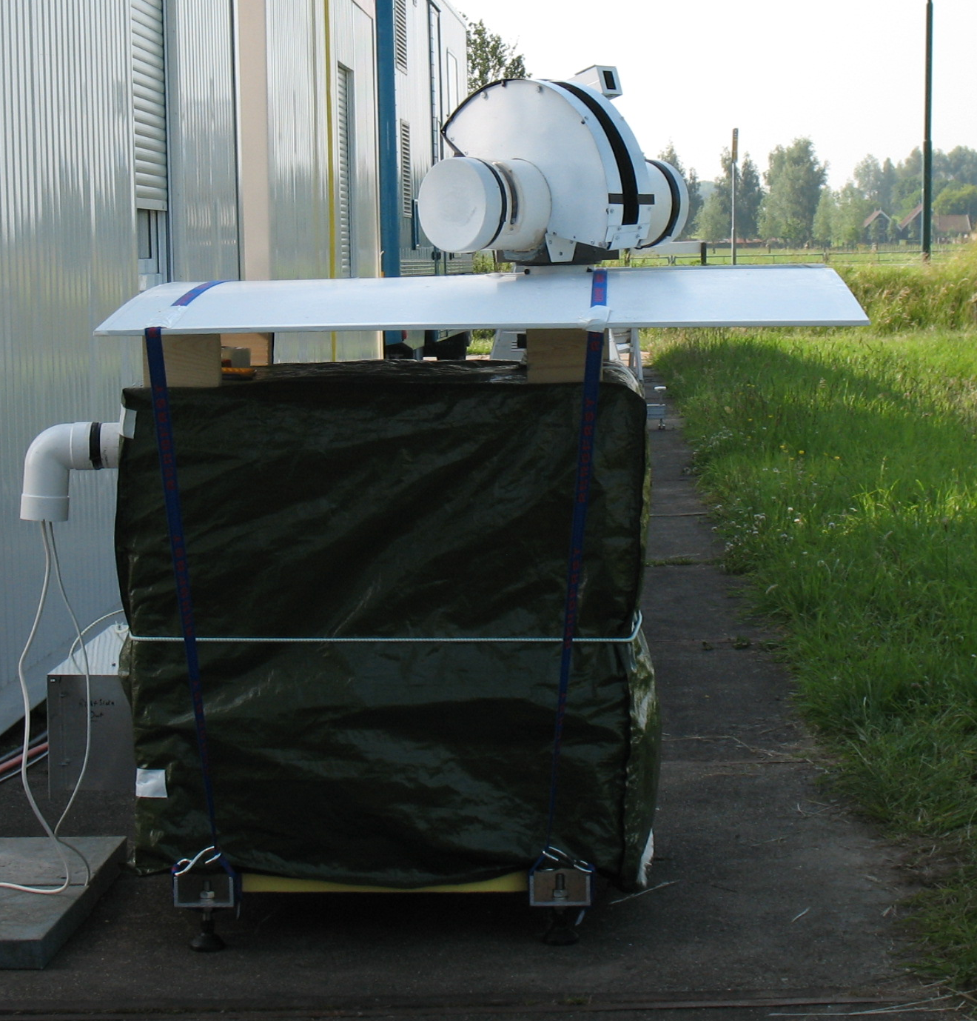
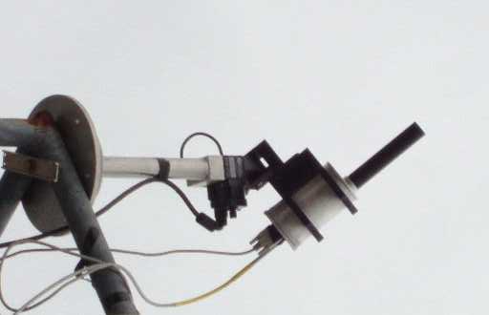
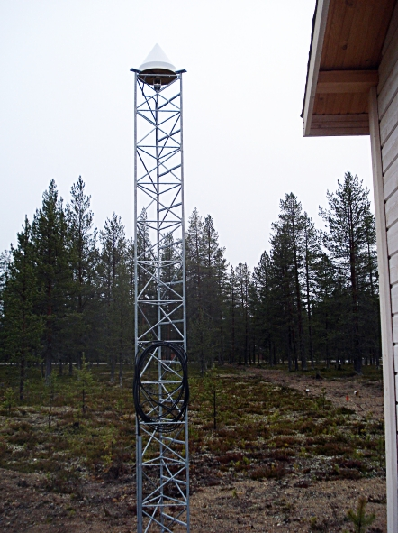
UV/visible spectroscopy:
O₃ total column
MAX-DOAS/PANDORA:
Tropospheric O₃
GNSS:
H₂O total column
To achieve reference quality, we need to establish full traceability and uncertainty quantification for each instrument type and a clear definition of measurement protocols.

Slide 6
K. Kreher (BKS)
M. De Maziere (BIRA), M. van Roozendael (BIRA), Bavo Langerock (BIRA)
D. Cimini (CNR), F. Madonna (CNR)
R. Kivi (FMI), ), J. Tamminen (FMI)
A. Apituley (KNMI)
S. Barthlott (KIT), T. Blumenstock (KIT), M. Schneider (KIT)
J. Jones (MO)
T. Leblanc (NASA JPL)
K. Rannat (TUT)
J. Notholt (UBremen)

