Slide 1

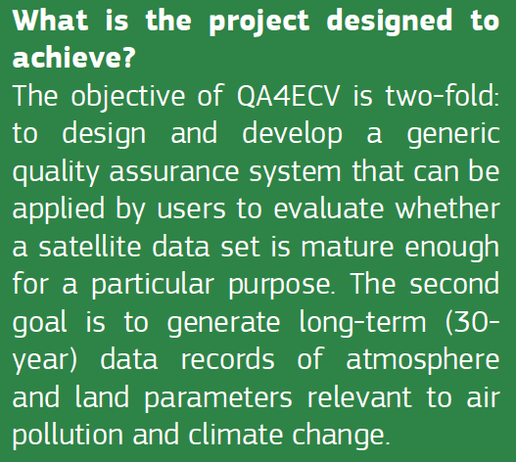
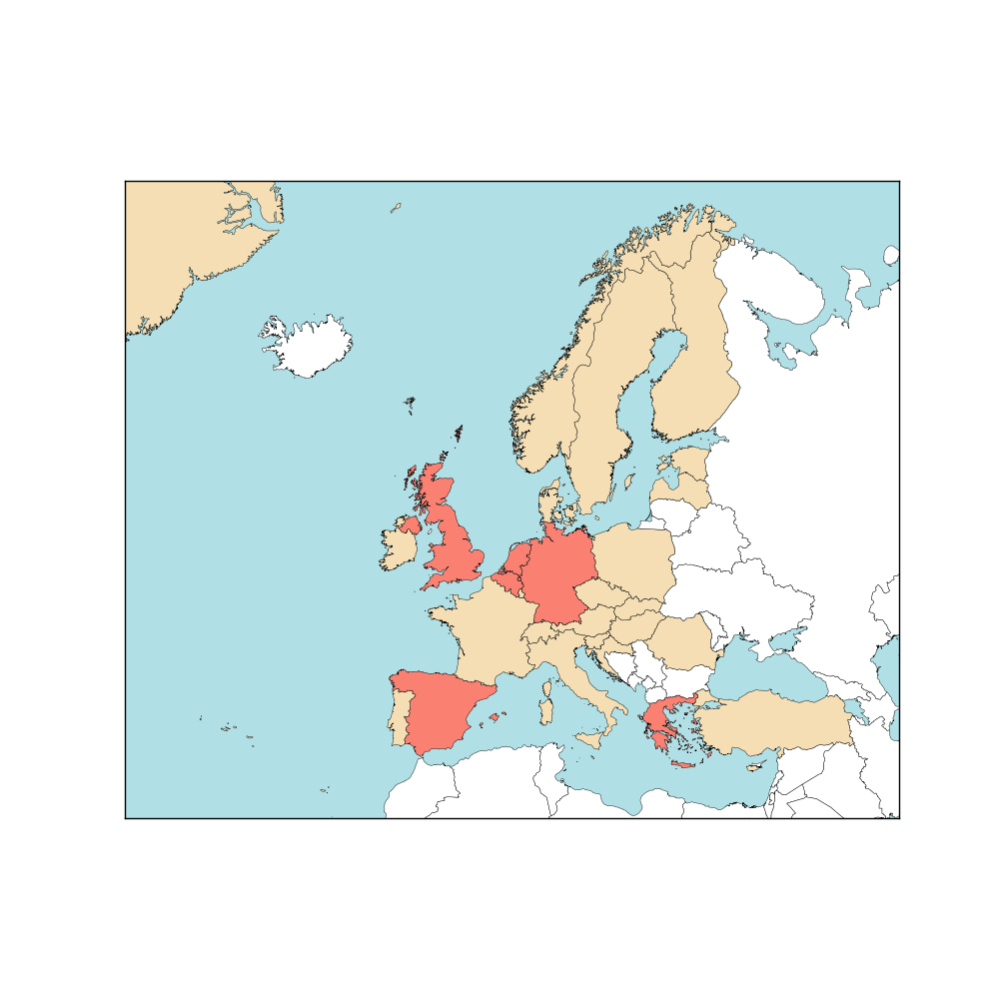

1. QA4ECV objectives
4-year EU FP7 Space project (2014 – 2017)
Led by KNMI with 17 contributing institutions
QA4ECV is a partnership of:
European scientists
data providers
developers of future climate services
national standards institute
international organisations

Slide 2
1. Detailed objectives of QA4ECV
1. Rigorous QA methodologies for satellite ECV products
  QA framework applicable to many ECVs
  SW tools for ‘do-it-yourself’ QA
  SI standards as in QA4EO (through NPL)
2. Multi-decadal satellite-derived global ECV records
  3 Terrestrial and 3 Atmospheric ECVs w/ global coverage
  Not yet covered by ESA or EUMETSAT activities; 20-30 yr
3. Traceable QA applied to ECV retrievals and products
  QA4ECV approach applied to independent reference data, ECV retrievals, and final products
4. Information on quality and fit-for-purpose nature of datasets
  QA Office to audit ECV records against GCOS, WMO crit.
  Assess impact of ECV records for applications
Notes:
Applications include model evaluation, trend analysis, variability analysis, inverse modelling, emission monitoring

Slide 3
2. Break-up of the work
time
Notes:
Science group works with an independent QA expert on creating a long-term ECV record (similar to ESA CCI & GMES services)
This builds on GECA experience
GREEN – LAND ECV experts / BLUE – ATMOSPHERE ECV experts

Slide 4
2. QA4ECV work plan
Work programme divided in 10 Work Packages
WP1. User engagement: requirements, outreach & useability
Identify user and supplier needs
Maintain dialogue with key (international) projects
Voice & ears of the project
WP2. Design & development of QA system for ECV validation
Develop and prototype QA service for ECV climate services (NPL)
Link to WP1 needs and ESA/EUMETSAT ECV activities
Generic and specific infrastructure for Land and Atmosphere ECV validation
SW to deliver final quality indicators (CGI IT, S [&] T)
WP3. QA of independent reference data
Generate long-term quality assured set of independent reference measurements
Evaluate in situ measurement methodologies / ‘virtual validation sites’
WP4. Harmonised ECV retrievals & multidecadal data records
Develop harmonised algorithms
Generate 3 Land and 3 Atmosphere data products
Notes:
Science group works with an independent QA expert on creating a long-term ECV record (similar to ESA CCI & GMES services)
This builds on GECA experience
GREEN – LAND ECV experts / BLUE – ATMOSPHERE ECV experts

Slide 5
2. QA4ECV work plan
WP5. QA of ECV products using traceable reference standards
Bring together system from WP2 with data from WP3 and WP4
Apply QA system to ECV retrievals and data producs
WP6. Fitness for purpose of products
Evaluate quality from WP5 against user requirements from WP1
Assess impact of quality ECV products on climate and air quality applications
WP7. Outreach, dissemination, and exploitation
Development of QA4ECV web-portal
Integration of web-service modules in project web-site (visualization, QA training course)
Promote QA4ECV concept and results at relevant international conferences
WP8. Overarching coordinationaa
Coordination with other FP7 Copernicus climate change projects
WP9. Project scientific & technological coordination
Notes:
Science group works with an independent QA expert on creating a long-term ECV record (similar to ESA CCI & GMES services)
This builds on GECA experience
GREEN – LAND ECV experts / BLUE – ATMOSPHERE ECV experts

Slide 6
QA4ECV WP3 – Tasks
Objective: Provide traceable quality assurance for the independent reference data used in the validation of satellite atmospheric ECV products (NO₂, HCHO, CO)
T3.5 - Establish independent Atmosphere reference data (M1-24)
Collect NO₂ and HCHO reference data from MAXDOAS sites. Agree on harmonised data processing, characterisation and reporting
T3.6 - Quality assurance of Atmosphere reference data (M13-30)
Characterize the uncertainties of MAXDOAS NO₂ and HCHO measurements, including cloud interference and spatial representativeness effects
T3.7 - Validation of Atmosphere reference data (M25-48)
Validate MAXDOAS data against long-path DOAS, in-situ and NO₂ sonde

Slide 7
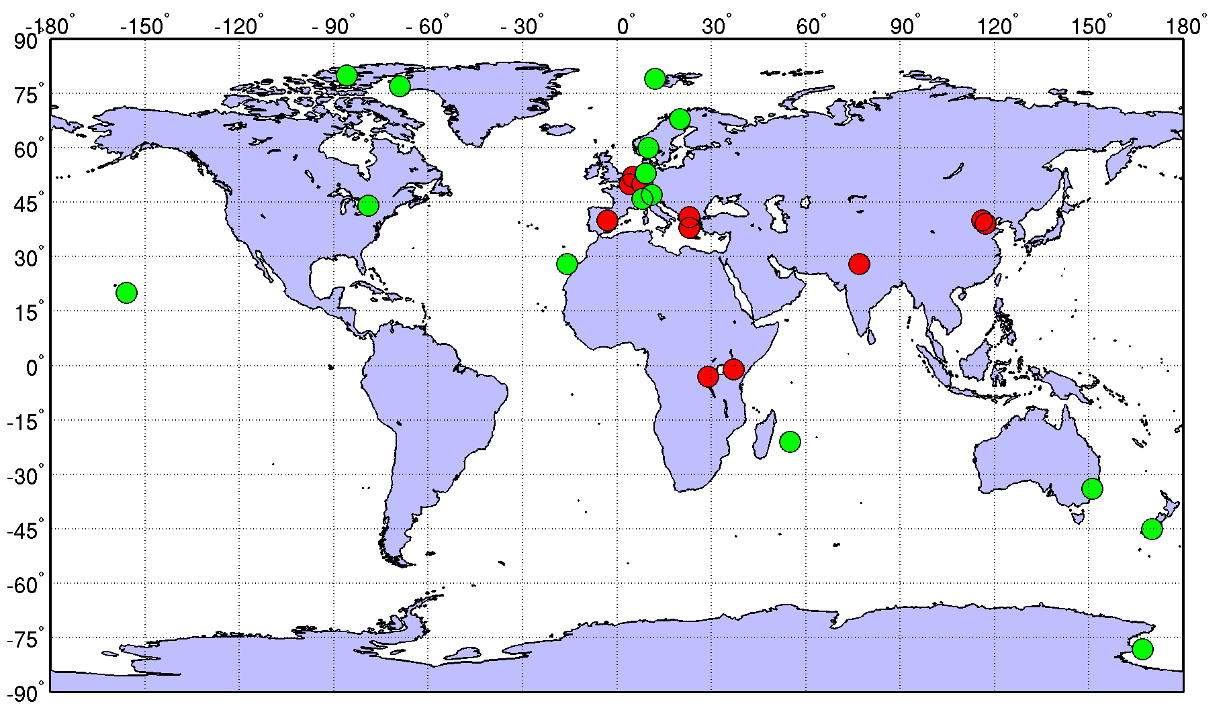
QA4ECV reference sites
FTIR sites
MAXDOAS sites

Slide 8
MAXDOAS reference sites for NO₂ and HCHO
MAXDOAS site | Lat, Long | Class | Data Source
De Bilt/Cabauw (NL) | 52°N, 5°E | Sub-urban | KNMI
Uccle (BE) | 50°N, 4°E | Urban | BIRA
Beijing (CHN) | 40°N, 116°E | Urban | BIRA, MPIC
Xianghe (CHN) | 39°N, 117°E | Sub-urban | BIRA
Bujumbura (BU) | 3°S, 29°E | Sub-urban | BIRA
Bremen (DE) | 53°N, 9°E | Urban | IUP-UB
Nairobi (KEN) | 1°S, 37°E | Rural / Urban | IUP-UB
Athens (GR) | 38°N, 23°E | Urban | IUP-UB
Mainz (DE) | 50°N, 8°E | Urban | MPIC
Greater Noida (IND) | 28°N, 77°E | Urban | MPIC
Thessaloniki (GR) | 41°N, 23°E | Urban | AUTH
Madrid (ESP) | 40°N, 3°W | Urban | CSIC

Slide 9
Overview of systems and procedures in place
 | BIRA | IUP | MPIC | KNMI | CSIC | AUTH
Instrument type | Own design (Xiang., Bur.), miniDOAS (Uccle) | Own design (1D or 2D) | Own design (Mainz), miniDOAS (Beijing) | Hoffmann- miniDOAS | Own design | Own design (Avantes 2D+DS)
Slant column retrieval Code Settings | - QDOAS - Settings based on CINDI | - NLIN-D - Settings based on CINDI | - WinDOAS, MDOAS - Settings based on CINDI | - Own code - Settings based on CINDI | - QDOAS - Settings based on CINDI | - QDOAS - Settings based on CINDI
Vertical column/profile retrieval Product Method Aerosol corr Cloud flagging | - Profiles - OE (bePro) LIDORT - O₄-based aerosol profile retrieval - Cloud flagging by Gielen et al. | - Profiles - OE (BREAM) - SCIATRAN - O₄-based aerosol correction - No cloud flag | - Profiles - Param. Method - Aerosol correction - Cloug flagging by Wagner et al. | - Columns - DAK-based code after Vlemmix et al., 2015 Cloud ceilometer - No flags, no aerosol corr. | - Columns + surf. Conc. - SCIATRAN/ LIDORT based own code - Cloud flagging using webcam | - Columns - Geometric approx. - No aerosol correction - Cloud flag based on pyranometer data
Data format | HDF-GEOMS | ASCII (own format) | ASCII (own) | ASCII (own) | NetCDF (own) | Matlab (own)

Slide 10
Harmonisation work plan
Review status of current systems and data evaluation procedures → this workshop
Standards for MAXDOAS operation (e.g. set of mandatory viewing angles)
Standards for slant column fitting
Standards for NO₂ and HCHO column and profile retrievals, and error/data characterization
Standards for cloud flagging, and general QC?
➔ Reprocess data base using standardised procedures and assess improvement in terms of consistency

Slide 11
WP 3 – Workplan 2015-2016
 | 2015 |  |  | 2016
 | Jun | Sep | Dec | Mar | Jun | Sep | Dec
Instrument characterization and operation protocol document | TOC | Draft |  |  | Final
MADCAT intercomparison of NO2 and HCHO SCD, VCD and profiles | Send SCDs and spectra | First results |  | Final results
LUTs of NO2 and HCHO AMFs |  | Review of concept | LUTs delivery | LUTs validation
Cloud flagging method |  | Final
GEOMS data formatting | Distribute information | Implement | Implement
NO2 and HCHO VCD data series |  |  | Initial data set |  | Harmonised data set
Error analysis and representativeness document |  |  |  | Draft | Final
Validation report |  |  |  |  |  | Draft | Final

